Slide 1
Unit No. I As Per SPP University Introduction to Hydraulics & Pneumatics 402041 Be 7th Sem 2015 Pattern
Dr. Sadanand S. Deshpande
Associate Professor (Mechanical Engineering)
Government College of Engineering & Research Avasari Dist Pune

Slide 2
Content
1. Introduction
2. Basic Laws Governing To Hydraulics & Pneumatics
3. Application of Pascal's law
4. Numerical on Pascal's law
5. Component of Hydraulic System
6. Component of Pneumatic System
7. Comparison of Hydraulics & Pneumatic System
8. Comparison of H&P system with conventional Transmission system
9. Hydraulic Fluids- Classification, Properties of Hydraulic Fluid
10. Hydraulic Filters
11. ISO symbols in Hydraulic & Pneumatics System
12. Energy Losses in Hydraulic System
13. Introduction to Pump, Working Principle
14 .Classification of Pumps, Comparison of Reciprocating & Hydrodynamic Pumps
15. Types of Reciprocating Pumps, Construction & working of Gear, Vane, Screw, Piston Pumps
16. Pump Performance calculation (i.e. calculate Qact., Vol. effi., Overall eff., Mech effi.) ,Characteristic curves for pump, Selection Criteria For Pumps
17.Numericals Based On Performance parameter calculation

Slide 3
INTRODUCTION
In the industry we use three methods for transmitting power from one point to another. Mechanical transmission is through shafts, gears, chains, belts, etc. Electrical transmission is through wires, transformers, etc.
Fluid power is through liquids or gas in a confined space. In this chapter, we shall discuss a structure of hydraulic systems and pneumatic systems.
Fluid power is the technology that deals with the generation, control and transmission of forces and movement of mechanical element or system with the use of pressurized fluids in a confined system.

Slide 4
Basic Laws Governing To hydraulics & Pneumatics
1.Pascals Law
2.Bernoullies Theorem
3. Torricelli's Equation
4. Continuity Equation
5. Law of Conservation of Energy

Slide 5
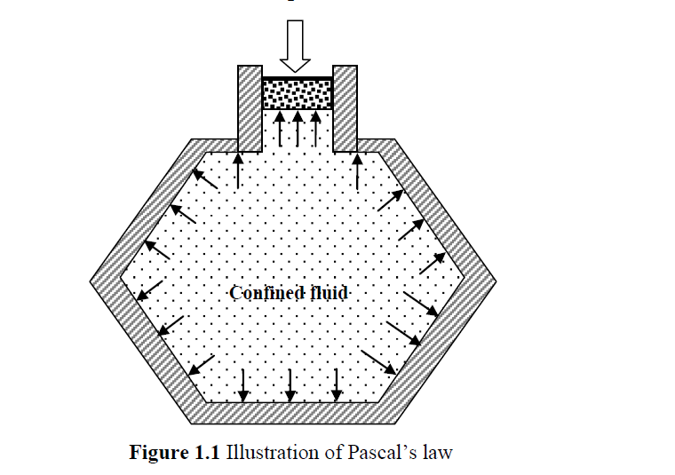
Pascal's law
Pascal’s law states that the pressure exerted on a confined fluid is transmitted undiminished in all directions and acts with equal force on equal areas and at right angles to the containing surfaces. In Fig. 1.1, a force is being applied to a piston, which in turn exerts a pressure on the confined fluid. The pressure is equal everywhere and acts at right angles to the containing surfaces. Pressure is defined as the force acting per unit area and is expressed as
Pressure p = F/A
where F is the force acting on the piston, A is the area of the piston and p is the pressure on the fluid.

Slide 6
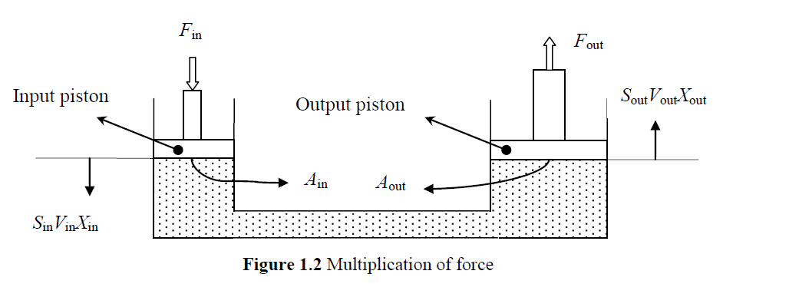

Multiplication Of Forces By Pascal's Law
The most useful feature of fluid power is the ease with which it is able to multiply force. This is accomplished by using an output piston that is larger than the input piston. Such a system is shown in Fig. 1.2. This system consists of an input cylinder on the left and an output cylinder on the right that is filled with oil. When the input force is Fin on the input piston, the pressure in the system is given by

Slide 7
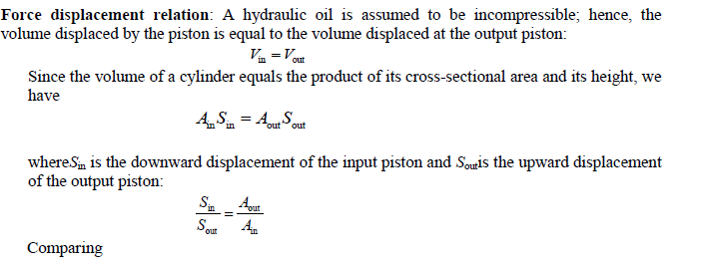


Slide 8
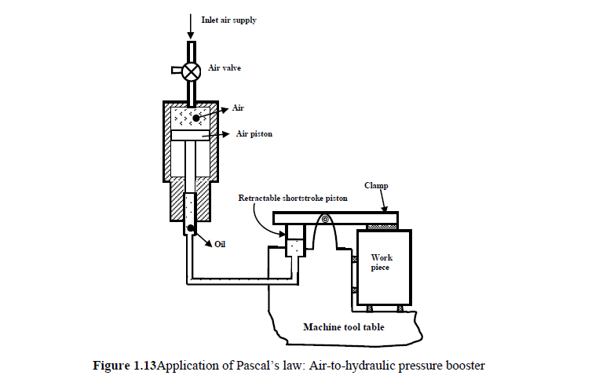
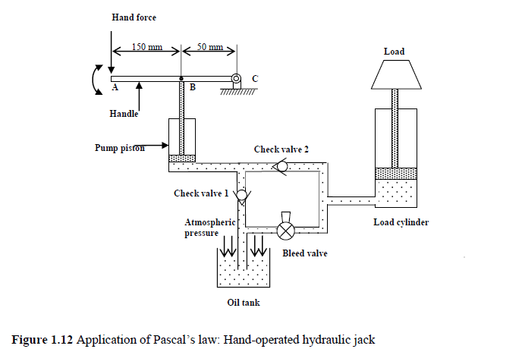
Application of Pascal's law

Slide 9
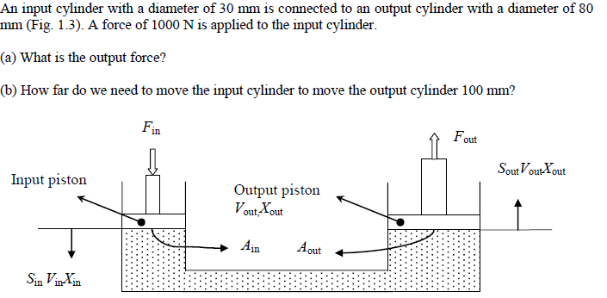
Numerical on Pascal's law
Ans: F out = 7111.1 N
S in = 14.4mm

Slide 10
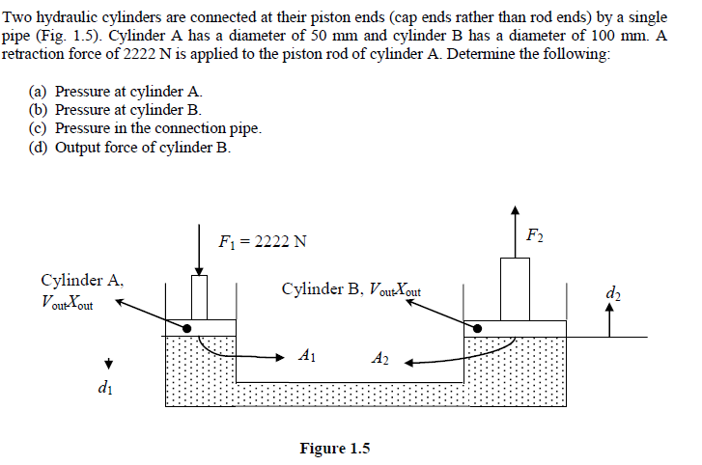
Ans a,b,c =1.132MPa
Ans d Force in cylinder B=8888N

Slide 11
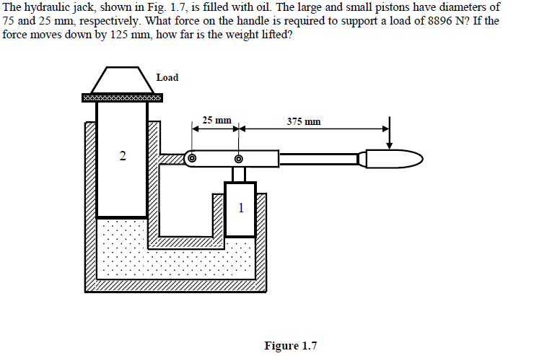
F= 61.78N
S=1mm

Slide 12
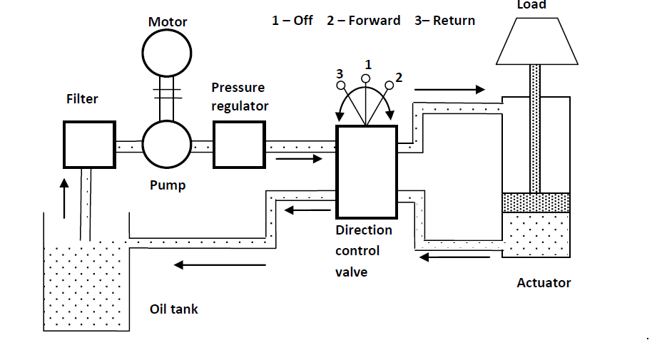
5.Components of Hydraulic System
Hydraulic systems are power-transmitting assemblies employing pressurized liquid as a fluid for transmitting energy from an energy-generating source to an energy-using point to accomplish useful work. Figure shows a simple circuit of a hydraulic system with basic components.

Slide 13
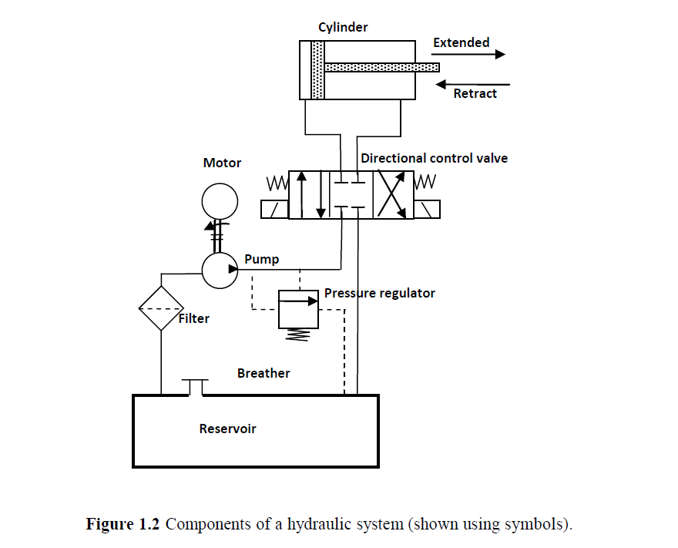
Components of Hydraulic System

Slide 14
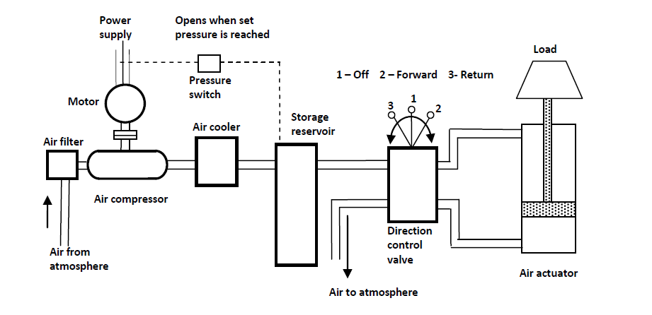
Components of Pneumatic System
A pneumatic system carries power by employing compressed gas, generally air, as a fluid for transmitting energy from an energy-generating source to an energy-using point to accomplish useful work. Figure shows a simple circuit of a pneumatic system with basic components.

Slide 15
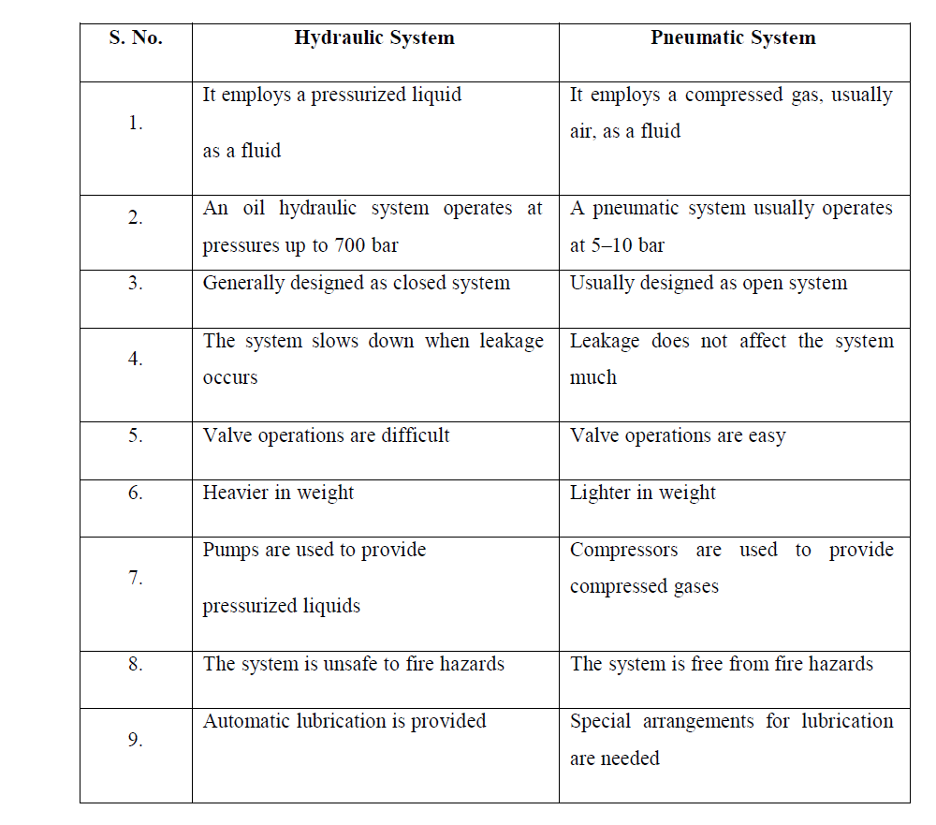
Comparison of Hydraulic & Pneumatic System

Slide 16
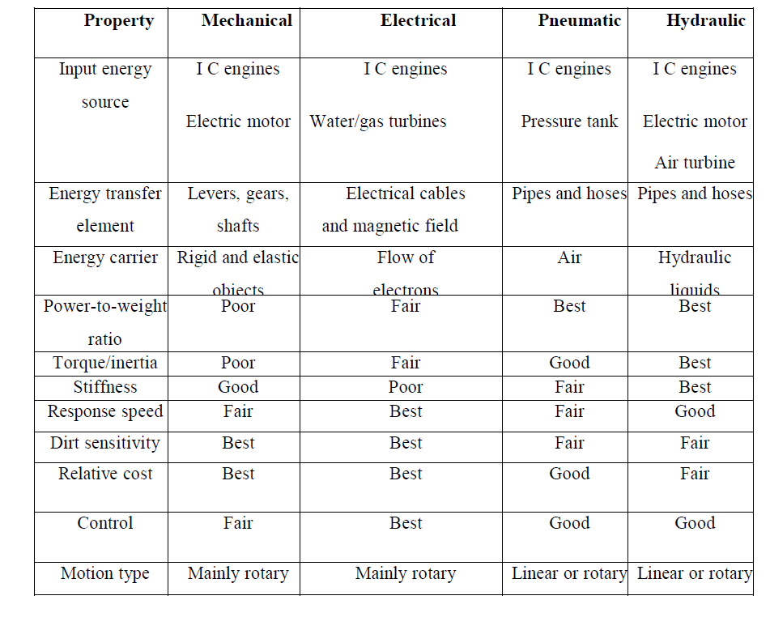
Comparison of H&P system with conventional Transmission system

Slide 17
Hydraulic Fluids
A hydraulic fluid is the transmitting medium of a hydraulic system. In fluid power systems, a hydraulic fluid has to perform various functions such as the following:
1. Power transmission: To transmit power, which is the primary function.
2. Lubrication: To lubricate various parts, so as to avoid metal-to-metal contact and reduce friction, wear and heat generation.
3. Sealing: To seal the moving elements to avoid leakage.
4. Cooling: To carry away the heat generated in the system and to dissipate the heat through a reservoir or a heat exchanger.
5. Contaminant removal: To carry along the contaminations to the tank, where they can be removed through filters.

Slide 18
Types of Hydraulic Fluids
There are five major types of hydraulic flow fluids which meet various needs of the system
Petroleum-based fluids
Emulsions
Water glycol
Synthetic fluids
Vegetable oils
Biodegradable hydraulic fluids

Slide 19
1. Petroleum-based fluids: Mineral oils are the petroleum-based oils that are the most commonly used hydraulic fluids . They offer the best lubrication
ability, least corrosion problems and are compatible with most seal materials. The only major disadvantage of these fluids is their flammability. They pose fire hazards, mainly from the leakages, in high-temperature environments such as steel industries, etc.
Mineral oils are good for operating temperatures below 50°C

Slide 20
2. Emulsions: Emulsions are a mixture of two fluids that do not chemically react with others. Emulsions of petroleum-based oil and water are commonly used. An emulsifier is normally added to the emulsion, which keeps liquid as small droplets and remains suspended in the other liquid. Two types of emulsions are in use:
A)Oil-in-water emulsions ( 5%Oil+95%Water)
B) Water-in-oil emulsions (40%Oil +60% Water)
These emulsions are good for operations at 25°C, as at a higher temperature, water evaporates and leads to the loss of fire-resistant properties.

Slide 21
3. Water glycol: Water glycol is another non-flammable fluid commonly used in aircraft hydraulic systems. It generally has a low lubrication ability as compared to mineral oils and is not suitable for high-temperature applications. It has water and glycol in the ratio of 1:1. Because of its aqueous nature and presence of air, it is prone to oxidation and related problems. It needs to be added with oxidation inhibitors

Slide 22
4. Synthetic fluids: Synthetic fluid, based on phosphate ester, is another popular fire-resistant fluid. It is suitable for high-temperature applications, since it exhibits good viscosity and lubrication characteristics. It is not suitable for low-temperature applications. It is not compatible with common sealing materials such as nitrile. Basically being expensive, it requires expensive sealing materials (viton). In addition, phosphate ester is not an environmental-friendly fluid. It also attacks aluminum and paints.

Slide 23
5. Vegetable oils: The increase in the global pollution has led to the use of more environmental-friendly fluids. Vegetable-based oils are biodegradable and are environmental safe. They have good lubrication properties, moderate viscosity and are less expensive .
6. Biodegradable hydraulic fluids:Biodegradable hydraulic fluids, alternatively known as bio-based hydraulic fluids, Bio-based hydraulic fluids use sunflower, rapeseed, soybean, etc., as the base oil and hence cause less pollution in the case of oil leaks or hydraulic hose failures. These fluids carry similar properties as that of a mineral oil–based anti-wear hydraulic fluid,

Slide 24
Properties of Hydraulic Fluid
For a fluid to perform efficiently, it must possess certain properties. Various properties required for an ideal hydraulic fluid are as follows:
1. Ideal viscosity & Viscosity Index
2. Good lubrication capability.
3. Demulsibility.
4. Good chemical and environmental stability.
5. Incompressibility.
6. Fire resistance.
7. Low flammability.
8. Foam resistance.
9. Low volatility.
10. Good heat dissipation.
11. Low density.
12. System compatibility.

Slide 25
1. Ideal viscosity: It is a measure of a fluid’s resistance to flow.
Effect of High viscosity: High resistance to flow. Increased power consumption due to frictional loss. High temperature caused by friction. Increased pressure drop because of the resistance. Possibility of sluggish or slow operation. Difficulty in separating air from oil in a reservoir. Greater vacuum at the pump inlet, causing cavitations. Higher system noise level.
Effect Of Low viscosity: Increased internal leakage. Excessive water. Possibility of decreased pump efficiency, causing slower operation of the actuator. Increased temperature resulting from leakage losses. Therefore the hydraulic fluid should have an optimum viscosity.
Viscosity Index: The viscosity index (VI) is a relative measure of the change in the viscosity of an oil with respect to a change in temperature. An oil having a low VI is one that exhibits a large change in viscosity with a small change in temperature. A high VI oil does not change appreciably with a change in temperature.

Slide 26
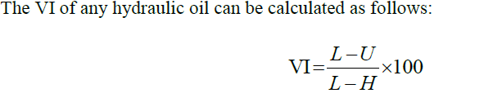
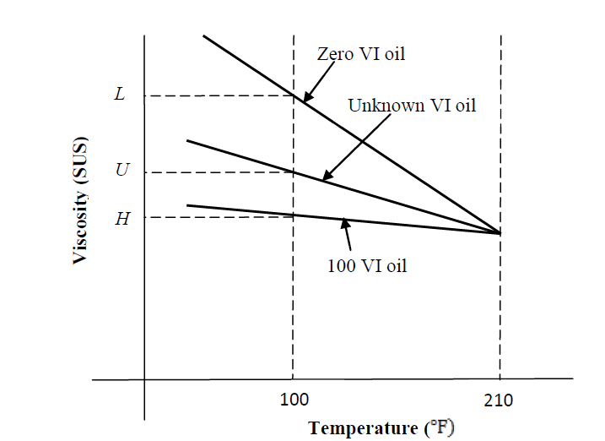

Slide 27
2.Good lubrication capability: Hydraulic fluids must have good lubrication to prevent friction and wear between the closely fitted working parts such as vanes of pumps, valve spools, piston rings and bearings .
3. Demulsibility: The ability of a hydraulic fluid to separate rapidly from moisture and successfully resist emulsification is known as “Demulsibility.
4.Good chemical and environmental stability: Most fluids are vulnerable to oxidation, as they come in contact with oxygen in air. Mineral oils or petroleum-based oils (widely used in hydraulic systems) contain carbon and hydrogen molecules, which easily react with oxygen

Slide 28
5. Incompressibility: the compressibility of a fluid is greatly influenced by temperature and pressure. The incompressibility of a fluid is a measure of its stiffness and is given by its bulk modulus. The bulk modulus (B) of a fluid is the ratio of volumetric stress to volumetric strain .
6. Fire resistance:. Flammability is defined as the ease of ignition and ability to propagate the flame. The following are the usual characteristics tested in order to determine the flammability of hydraulic fluids:
1. Flash point: The temperature at which an oil surface gives off sufficient vapours to ignite when a flame is passed over the surface.
2. Fire point: The temperature at which an oil releases sufficient vapours to support
combustion continuously for 5 s when a flame is passed over the surface.
3. Autogenously ignition temperature: The temperature at which ignition occurs spontaneously

Slide 29
7. Low flammability: A fire-resistant fluid is one that can get ignited in the presence of an ignition source but does not support combustion when the source is removed. This characteristic is defined as flammability.
8. Foam resistance: Air can be present in a hydraulic fluid in two forms dissolved and entrained. For example, if the return line to the reservoir is not submerged, the jet of oil entering the liquid surface will carry air with it.
9. Low volatility: A fluid should possess low vapor pressure or high boiling point. The vapour pressure of a fluid varies with temperature and hence the operating temperature range of the system is important in determining the stability of the fluid.

Slide 30
10. Good heat dissipation: A hydraulic fluid should have a high heat dissipation capability .
11. Low density: The relative density of a mineral oil is 0.9 (the exact value depends on the base oil and the additive used). Synthetic fluids can have a relative density greater than 1.
12. System compatibility: A hydraulic fluid should be inert to materials used in or near the hydraulic equipment. If the fluid in anyway attacks, destroys, dissolves or changes the parts of hydraulic system, the system may lose its functional efficiency and may start malfunction.

Slide 31
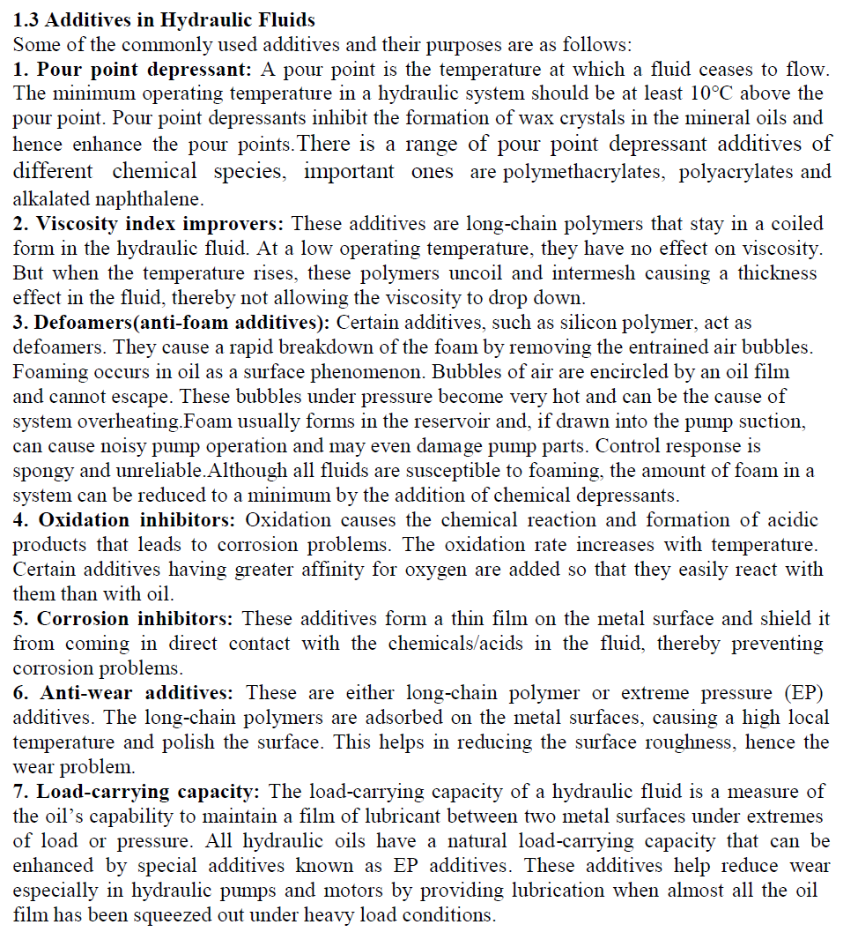

Slide 32
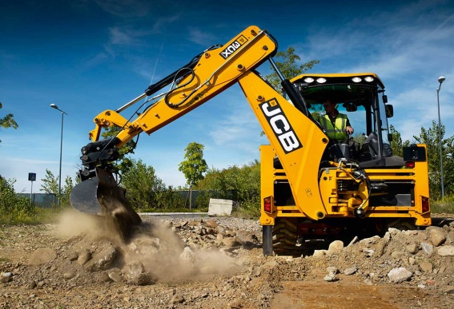
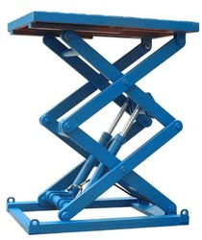
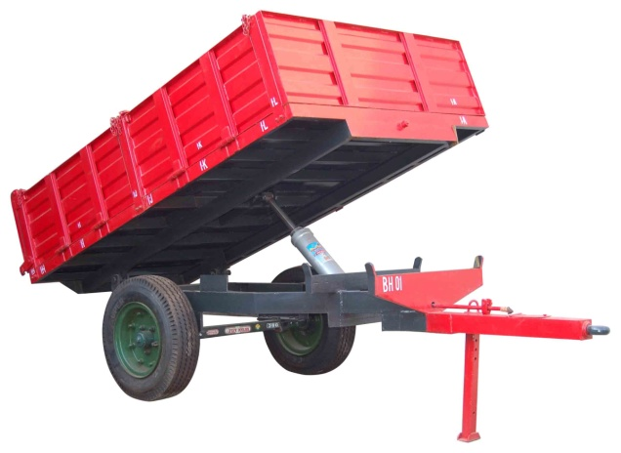
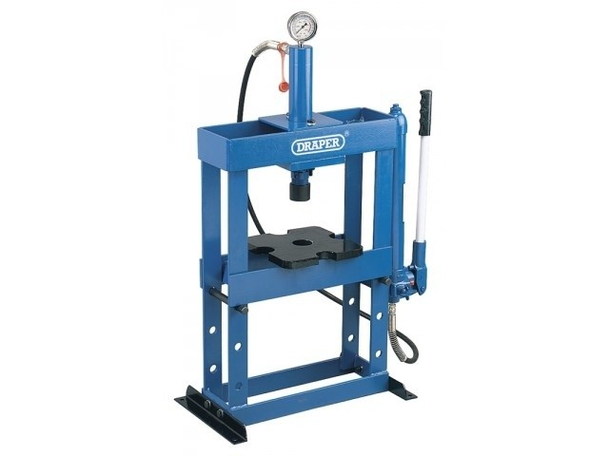
Applications of Fluid Power
Machine Tools & production
Material Handling
Hydraulic Press
Mobile & Stationery machine( JCB, Excavator, Digger)
Agriculture ( Tractor, Chemical & fertilizer Sprayer)
Automobile (Suspension, Brakes, Steering)
Processing Industry
Glass Industry
9. Complex instruments in space rockets, gas turbines, nuclear power plants, industrial labs .
10. Process control systems such as bottle filling, tablet placement, packaging

Slide 33

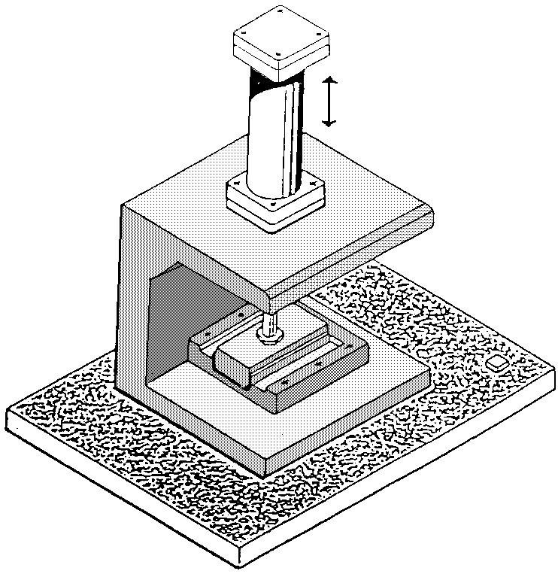
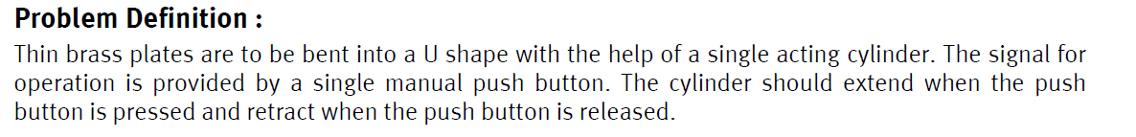

Slide 34
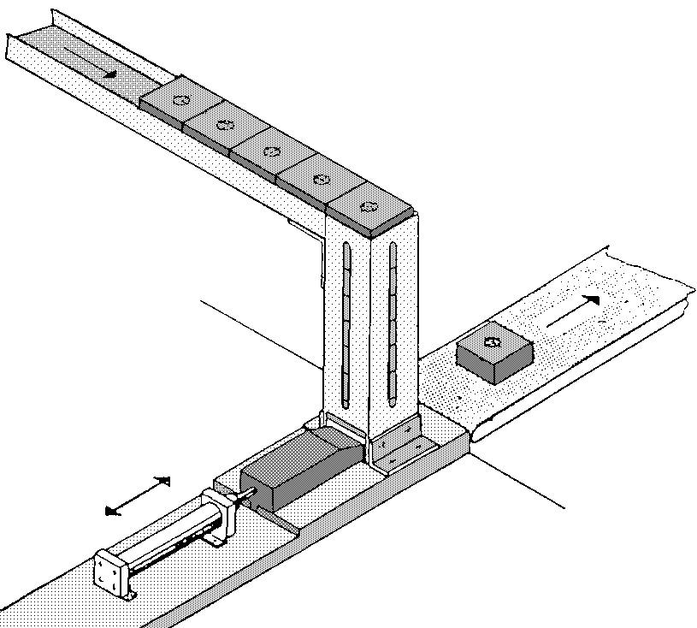
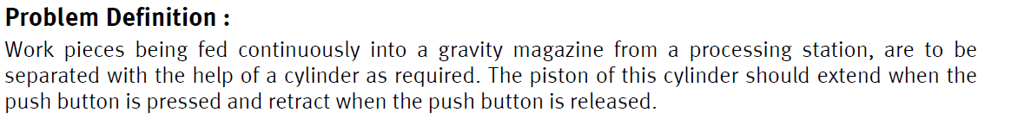

Slide 35

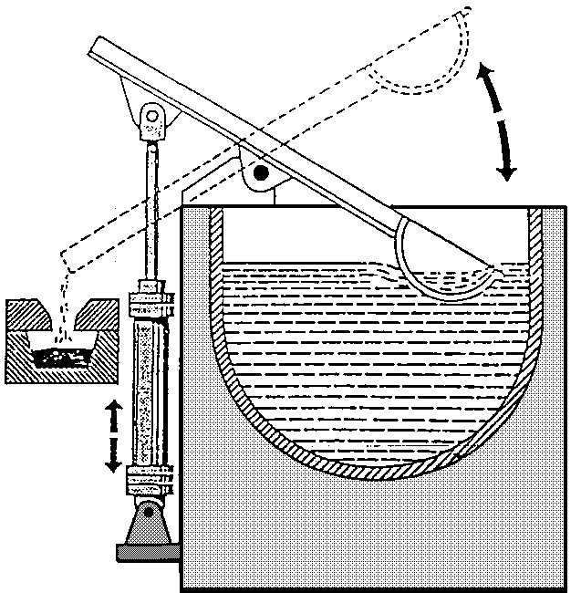
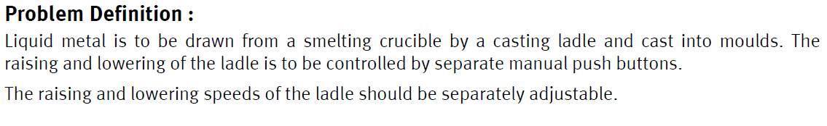

Slide 36

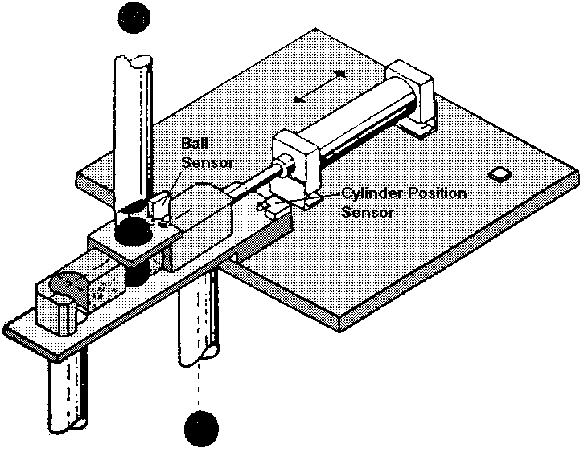
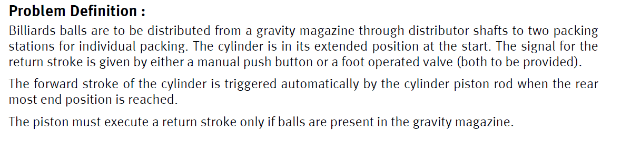

Slide 37

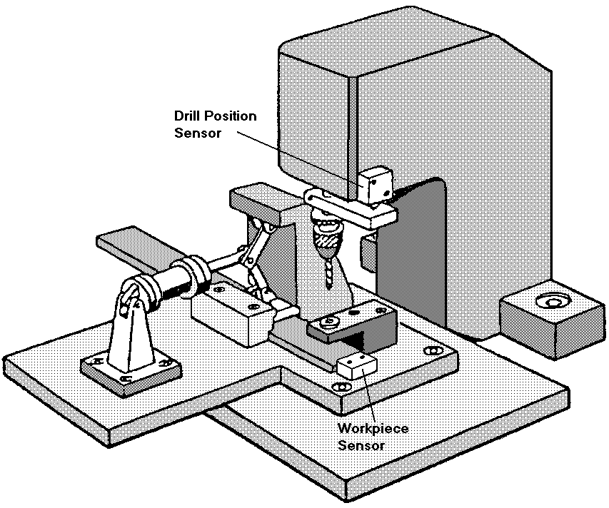
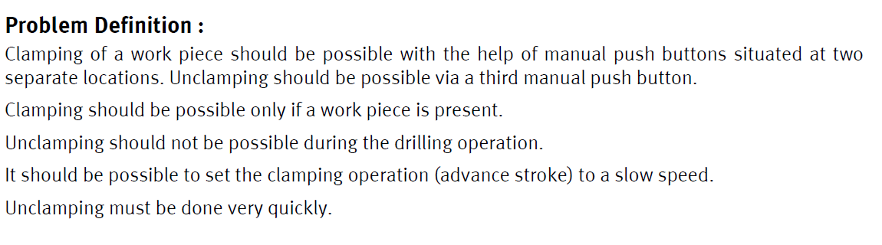

Slide 38

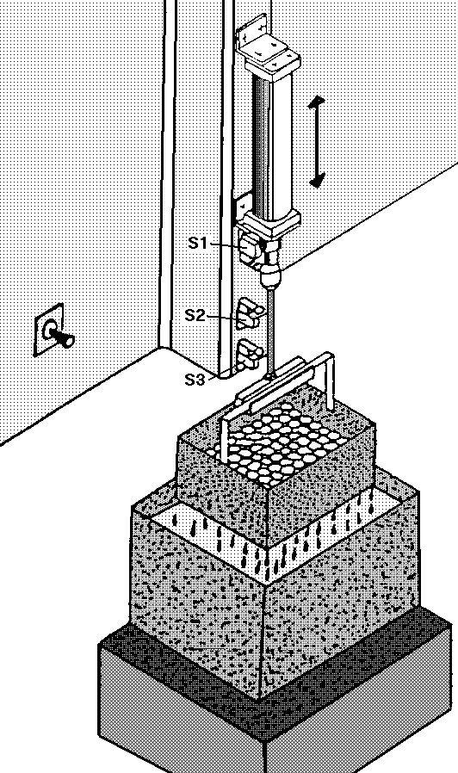
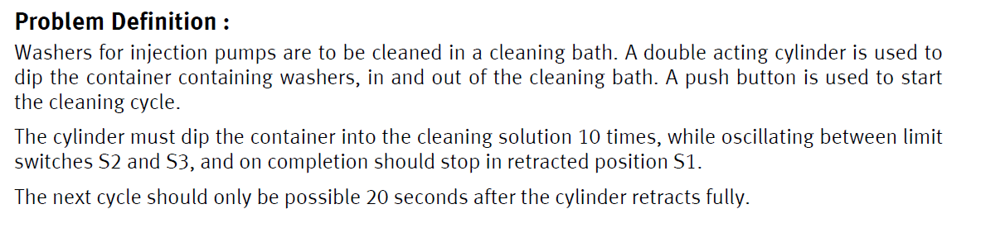

Slide 39
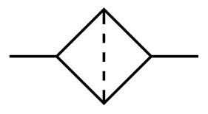
Hydraulic Filter
Filters & strainers are devices for trapping the insoluble contaminants by some porous medium.
A filter is system of fine gauge meshes with depth. When the liquid passes through meshes or any other medium, the filter element will retain insoluble impurities .The particle size removed by filter is measured in microns. This is called rating of filter.
Strainers are similar to filter but without any depth. Their efficiency is less than Filter.
Materials For filter:
Metallic Filter (Edge Type)
Mesh & cloth ( Mesh of synthetic rubber, Loose of fibers of cotton or cellulose )
Symbolic Representation

Slide 40
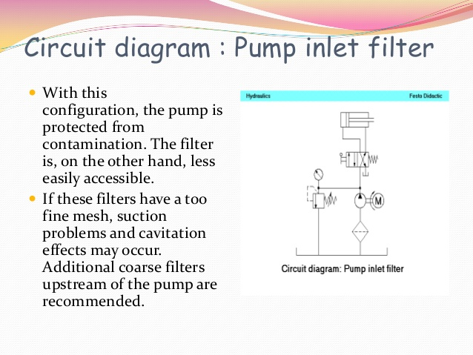

Slide 41
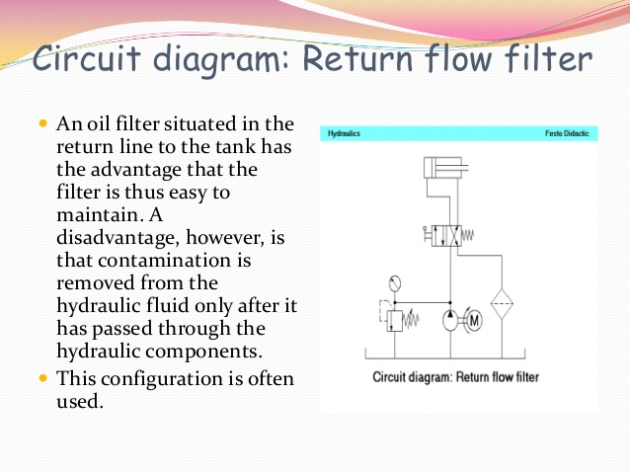

Slide 42
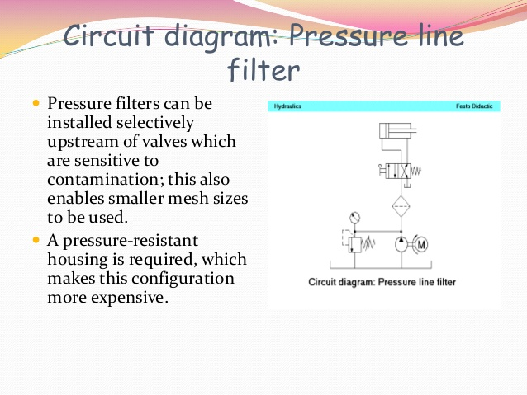

Slide 43
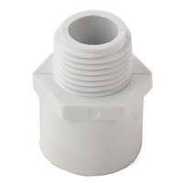
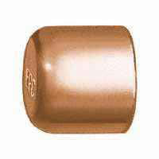
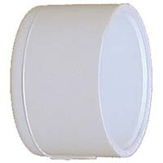
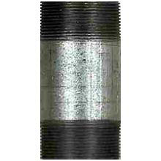
Adaptor fittings
These are used to change the end of a non-threaded pipe to male or female threads as needed. Adaptors are commonly used in copper and plastic plumbing jobs.
For example adaptors are used to convert from a PVC glue connection to a threaded connection or from a copper soldered connection to a threaded connection.
Male adapters and female adapters are both common.
Caps
Used to close the end of a dead end pipe.
Plugs
Nipples
Wyes

Slide 44
OIL RESERVOIR
Functions :
Storage of hydraulic oil volume
Cooling of oil
Expansion of fluid
Removal of air
Settling of contaminations
Structural supports
Easy access
Types of Reservoir:
Pressurized reservoir ( Press. inside reservoir is up to 5-7 bar)
Non-Pressurized ( Press inside reservoir is up to atmospheric press.)
Open Reservoir
Closed Reservoir

Slide 45
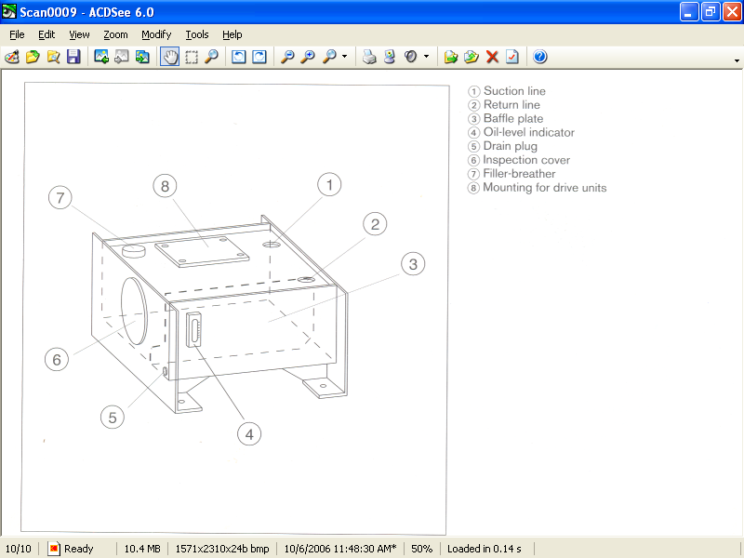
Construction and mountings

Slide 46
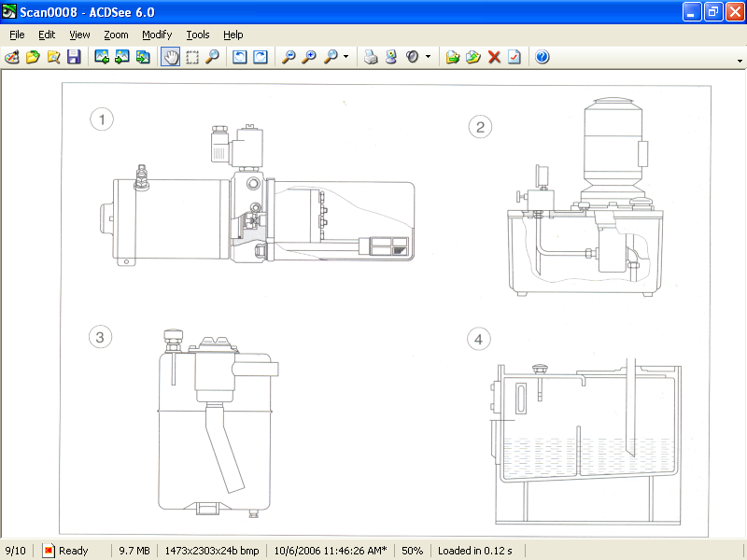
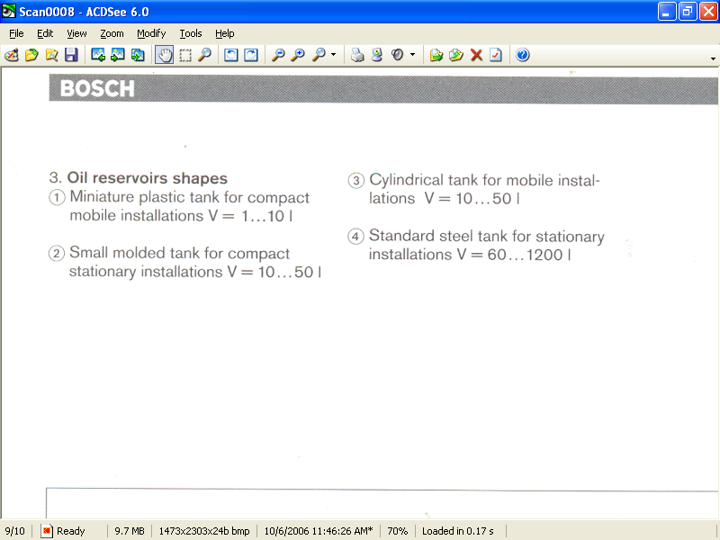
Oil reservoir size
For better heat dissipation and air separation, the oil reservoir must be as large as possible.
V= 3… 5 q for stationary installations
V= 1….1.5 q for mobile installation
10…15% of V is provided extra for variations in the oil level.

Slide 47
Energy Losses In Hydraulic System
Energy losses occur in valves and fittings. Various types of fittings, such as bends, couplings, tees, elbows, filters, strainers, etc., are used in hydraulic systems. The nature of path through the valves and fittings determines the amount of energy losses. The more circuitous is the path, the greater are the losses. In many fluid power applications, energy losses due to flow in valves and fittings exceed those due to flow in pipes. The energy equation and the continuity equation can be used to perform a complete analysis of a fluid power system.
Energy Losses Categorized in Two Types in Hydraulic system:
1.Major Losses ( Losses due to Friction generated during Fluid flow)
2.Minor Losses (Losses Due To sudden change in c/s , due to bend & due to pipe fitting)

Slide 48
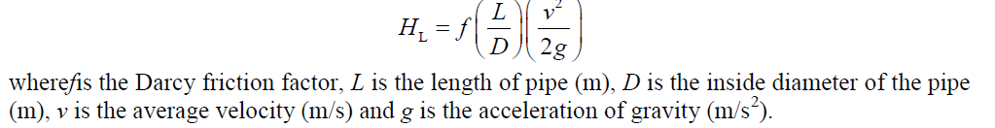
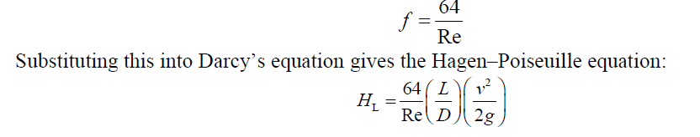
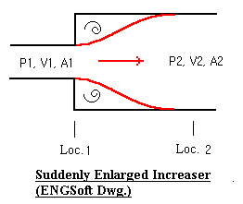
1.Frictional losses:
This is given by Darcy–Weisbach Equation:
Re< 2000 for laminar flow
Re>4000 for Turbulent flow
2.Loss of Head due to sudden Enlargement
h_{e}=(V₁-V₂)²/2g

Slide 49
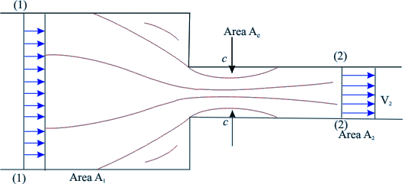
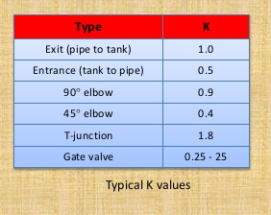
3.Loss of Head Due to Contraction
h_{c}=(V₂)²/2g
4.Loss of Head due to Bend & fitting
h_{b}=kV²/2g

Slide 50
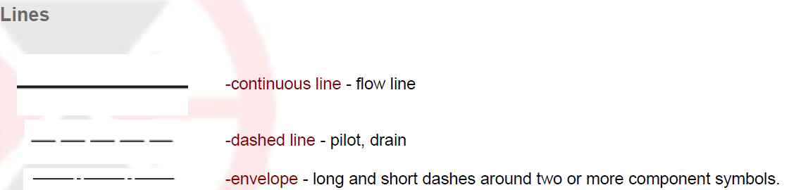
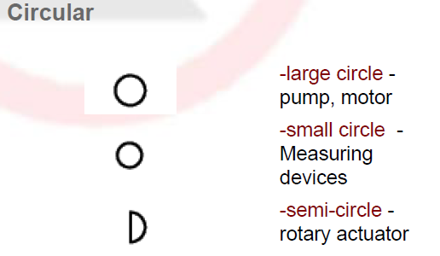




ISO symbols in Hydraulic & Pneumatics System

Slide 51






Slide 52







Slide 53






Slide 54



Pressure Control valve symbols
Pilot-Operated Relief Valve
Pressure-Reducing Valve
Unloading Valve
Counterbalance valves
Sequence Valve

Slide 55










Direction Control valve Symbol
Check valves
Shuttle valves
3/2 way valve : 3ports and 2 position DCV
4/3 Closed centre D.C.V
4/3TandemCentre
4/2 Solenoid Operated D.C.V.
5/2 Solenoid Operated D.C.V.
4/3 Floating Neutral
4/3 Open Center
4/3 Regenerative Center

Slide 56




Flow Control valve Symbol
Variable Flow Control Valve
Pressure compensated F.C.V.
Press. & temp. Compensated F.C.V.
Flow control Valve with integral Check Valve

Slide 57












Auxiliary Devices in FPS
Accumulators
Gas Charged Without Separator
Dead Weight Type
Spring Loaded Type
Gas Charged With separator
Press. Guage
Flow meter
Prime Mover Electric Motor
Cooler
Heater
Telescopic Cylinders

Slide 58

Hydraulic Pump
The function of a pump is to convert mechanical energy into hydraulic energy. It is the heart of any hydraulic system because it generates the force necessary to move the load.
Mechanical energy is delivered to the pump using a prime mover such as an electric motor.
Partial vacuum is created at the inlet due to the mechanical rotation of pump shaft. Vacuum permits atmospheric pressure to force the fluid through the inlet line and into the pump.
The pump then pushes the fluid mechanically into the fluid power actuated devices such as a motor or a cylinder.

Slide 59
Classification Of Hydraulic Pump
Pumps are classified into three different ways and must be considered in any discussion of fluid power equipment.
1. Classification based on displacement:
• Non-positive displacement pumps (hydrodynamic pumps).
• Positive displacement pumps (hydrostatic pumps).
2. Classification based on delivery:
• Constant delivery pumps.
• Variable delivery pumps.
3. Classification based on motion:
• Rotary pump.
• Reciprocating pump.

Slide 60


Comparison
It delivers fluids in discrete volume/cycle.
Discharge is independent on pess. @ delivery ( external load)
Discharge depends on speed
There is positive sealing between low & high press zone.
Energy imparted to fluid in form of pressure energy
No limit for max. press that can build in system
1.The delivery is continuous.
2.As external load increases discharge press. Decreases
3.Discharge depend on resisting pressure.
4.No positive sealing.
5.Energy imparted to fluid in the form of kinetic energy
Max. pressure developed in system is limited.

Slide 61
Types of Positive displacement pumps (hydrostatic pumps).
Positive displacement pumps
Rotary Pump
Reciprocating Type
Gear Pump
Vane Pump
Screw Pump
Axial Piston Pump
Radial Piston Pump
External Gear
Internal Gear
Fixed Delivery
Variable delivery
Rotating Cylinder Type Bent Axis
Swash Plate Type

Slide 62


Construction & Working of Gear Pump
The advantages are as follows:
1.They are self-priming. 2.They give constant delivery for a given speed.
3. They are compact and light in weight. 4. Volumetric efficiency is high.
The disadvantages are as follows:
1. The liquid to be pumped must be clean, otherwise it will damage pump.
2. Variable speed drives are required to change the delivery.

Slide 63


Construction & working of Vane Pump
Vane Pumps :
There are two types of vane pumps:
1. Unbalanced vane pump: Unbalanced vane pumps are of two varieties:
• Unbalanced vane pump with fixed delivery.
• Unbalanced vane with variable delivery
2. Balanced vane pump.
pump with pressure-compensated variabvery.

Slide 64

Expression for the Theoretical Discharge of Vane Pumps

Slide 65


Unbalanced vane Pump with variable delivery

Slide 66


Balanced vane pump

Slide 67

Construction & working of screw Pump
The advantages are as follows:
1.They are self-priming and more reliable. 2. They are quiet due to rolling action of screw spindles. 3.They can handle liquids containing gases and vapour. 4. They have long service life.
The disadvantages are as follows:
1.They are bulky and heavy.
2.They are sensitive to viscosity changes of the fluid.
3. They have low volumetric and mechanical efficiencies

Slide 68



Axial Piston Pump
1.Bent-Axis-Type Axial Piston Pump

Slide 69


2. Swash Plate Type Axial Piston Pump

Slide 70



Volumetric Displacement and Theoretical Flow Rate of an Axial Piston Pump
Let θ be an offset angle, S the piston stroke in m, D the piston circle diameter, Y the number of pistons, A the piston area inm2, N the piston speed in RPM and the theoretical flow rate in m3/min. Qth.

Slide 71



Performance curve for Pumps
Comparison For Different types of Positive displacement Pump

Slide 72
Selection Criteria For Pump
The main parameters affecting the selection of a particular type of pump are as follows:
1. Maximum operating pressure.
2. Maximum delivery.
3. Type of control.
4. Pump drive speed.
5. Type of fluid.
6. Pump contamination tolerance.
7. Pump noise.
8. Size and weight of a pump.
9. Pump efficiency.
10. Cost.
11. Availability and interchange ability.
12. Maintenance and spares.

Slide 73



Pump Performance calculation
1. Volumetric efficiency :It is the ratio of actual flow rate of the pump to the theoretical flow rate of the pump. This is expressed as follows:
Volumetric efficiency indicates the amount of leakage that takes place within the pump. This is due to manufacture tolerances and flexing of the pump casing under designed pressure operating conditions.
For gear pumps, = 80%–90%.
For vane pumps, = 92%.
For piston pumps, = 90%–98%.
2. Mechanical efficiency: It is the ratio of the pump output power assuming no leakage to actual power delivered to the pump

Slide 74








3. Overall efficiency :It is defined as the ratio of actual power delivered by the pump to actual power delivered to the pump
Qth.. For Gear Pump
Qth.. For Vane Pump
Qth. For Piston Pump

Slide 75
Numerical Based On Performance Parameter Calculation
Exe.1 A pump has a displacement volume of 98.4 cm3. It delivers 0.0152 m3/s of oil at 1000 RPM and 70 bar. If the prime mover input torque is 124.3 Nm. What is the overall efficiency of pump? What is the theoretical torque required to operate the pump? (Ans: Overall effi. =81.74%,Tth= 109.6 N-m)
Exe.2 How much hydraulic power would a pump produce when operating at 140 bar and delivering 0.001 m3/s of oil? What power rated electric motor would be selected to drive this pump if its overall efficiency is 85%?
( Ans: Hydraulic Power=14Kw, Electric Motor Power= 16.7Kw)
Exe.3 Determine the overall efficiency of a pump driven by a 10 HP prime mover if the pump delivers fluid at 40 LPM at a pressure of 10 MPa.
(Ans: I/P Power=7460 W, Overall Effi. =89.4%)
Exe.4 A pump having a volumetric efficiency of 96% delivers 29 LPM of oil at 1000 RPM. What is the volumetric displacement of the pump?
( Vd= 0.0302L/rev)
Exe.5 A gear pump has an outside diameter of 82.6 mm, inside diameter of 57.2 mm and a width of 25.4 mm. If the actual pump flow is 1800 RPM and the rated pressure is 0.00183 what is the volumetric efficiency?
( Ans: Qth.= 0.002125 m3/s , Vol .Eff.= 86.11%)

Slide 76
Exe.5 What is the theoretical flow rate from a fixed-displacement axial piston pump with a nine-bore cylinder operating at 2000 RPM? Each bore has a diameter of 15 mm and stroke is 20 mm. (Ans: 63.6 Lpm)
Exe.6 A gear pump has an outside diameter of 80mm, inside diameter of 55mm and a width of 25mm. If the actual pump flow is 1600 RPM and the rated pressure is 95 LPM what is the volumetric displacement and theoretical discharge (Ans: Qth.= 0.106 m3/min.)
Exe.7 A Gear pump has a outside diameter of 100 mm. inside diameter of 80 mm width of gear 25mm. If the actual flow of pump is 95lpm &pump speed is 1440rpm. What is volumetric displacement, theoretical discharge & volumetric efficiency (Vd=7.0685*10-5 m3/rev, Qth.=0.10178m3/min, vol.effi.=93.33%)
Exe.8 A gear pump outside diameter of 100 mm & having modules of4 mm & 20degree angle & 20 mm width .It delivers 80Lpm oil while operating at 1800rpm. At pressure 10Mpa.The actual torque of the prime mover is 100 Nm .
Determine: 1) Overall Effi. 2)Theorotical Torque
(use Addendum= 1m , Dedendum =1.25m, m=module).
(Ans:Di=82,voleff.=86.36%,mech.Eff.=81.89%,overalleff.=70.72%,Tth=81.89Nm)

Slide 77
Exe. 9 An Axial Piston pump having nine cylinder have 15mm dia. Arrange 150mm p.c.d. They are operated at a speed of 3200rpm & deliver 190 Lpm at rated pressure . Calculate the volumetric efficiency of pump(Take : angle= 15degree)
Exe.10 The displacement of pump operating at 1000 rpm at a pressure of 70 bar is 100cm3. The input torque from prime mover is 120 Nm . If it deliver 0.00015m3/sec of oil .Determine 1)overall eff.2) Therotical Torque3) Vol. Effi.

Slide 78
Thanks for sharing his PPT. I modified it to suit contents as per SPPU 2015 pattern
Mr. R.G. Mahajan
Asst Professor (Mechanical Engg)
MMIT ,Pune
Please see other PPTs by me. Shared on website/ Google drive

